Slide 1
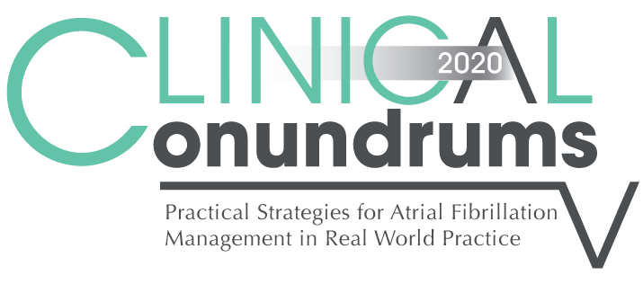
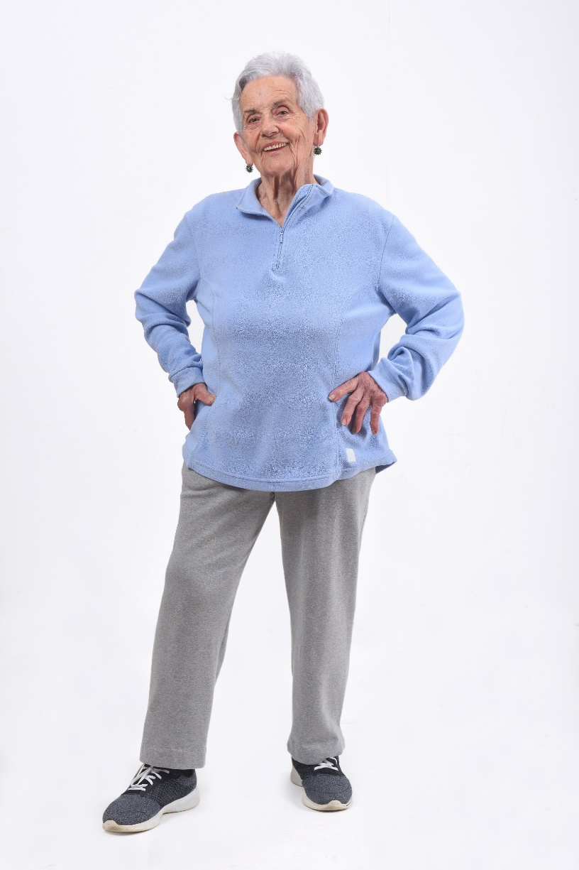

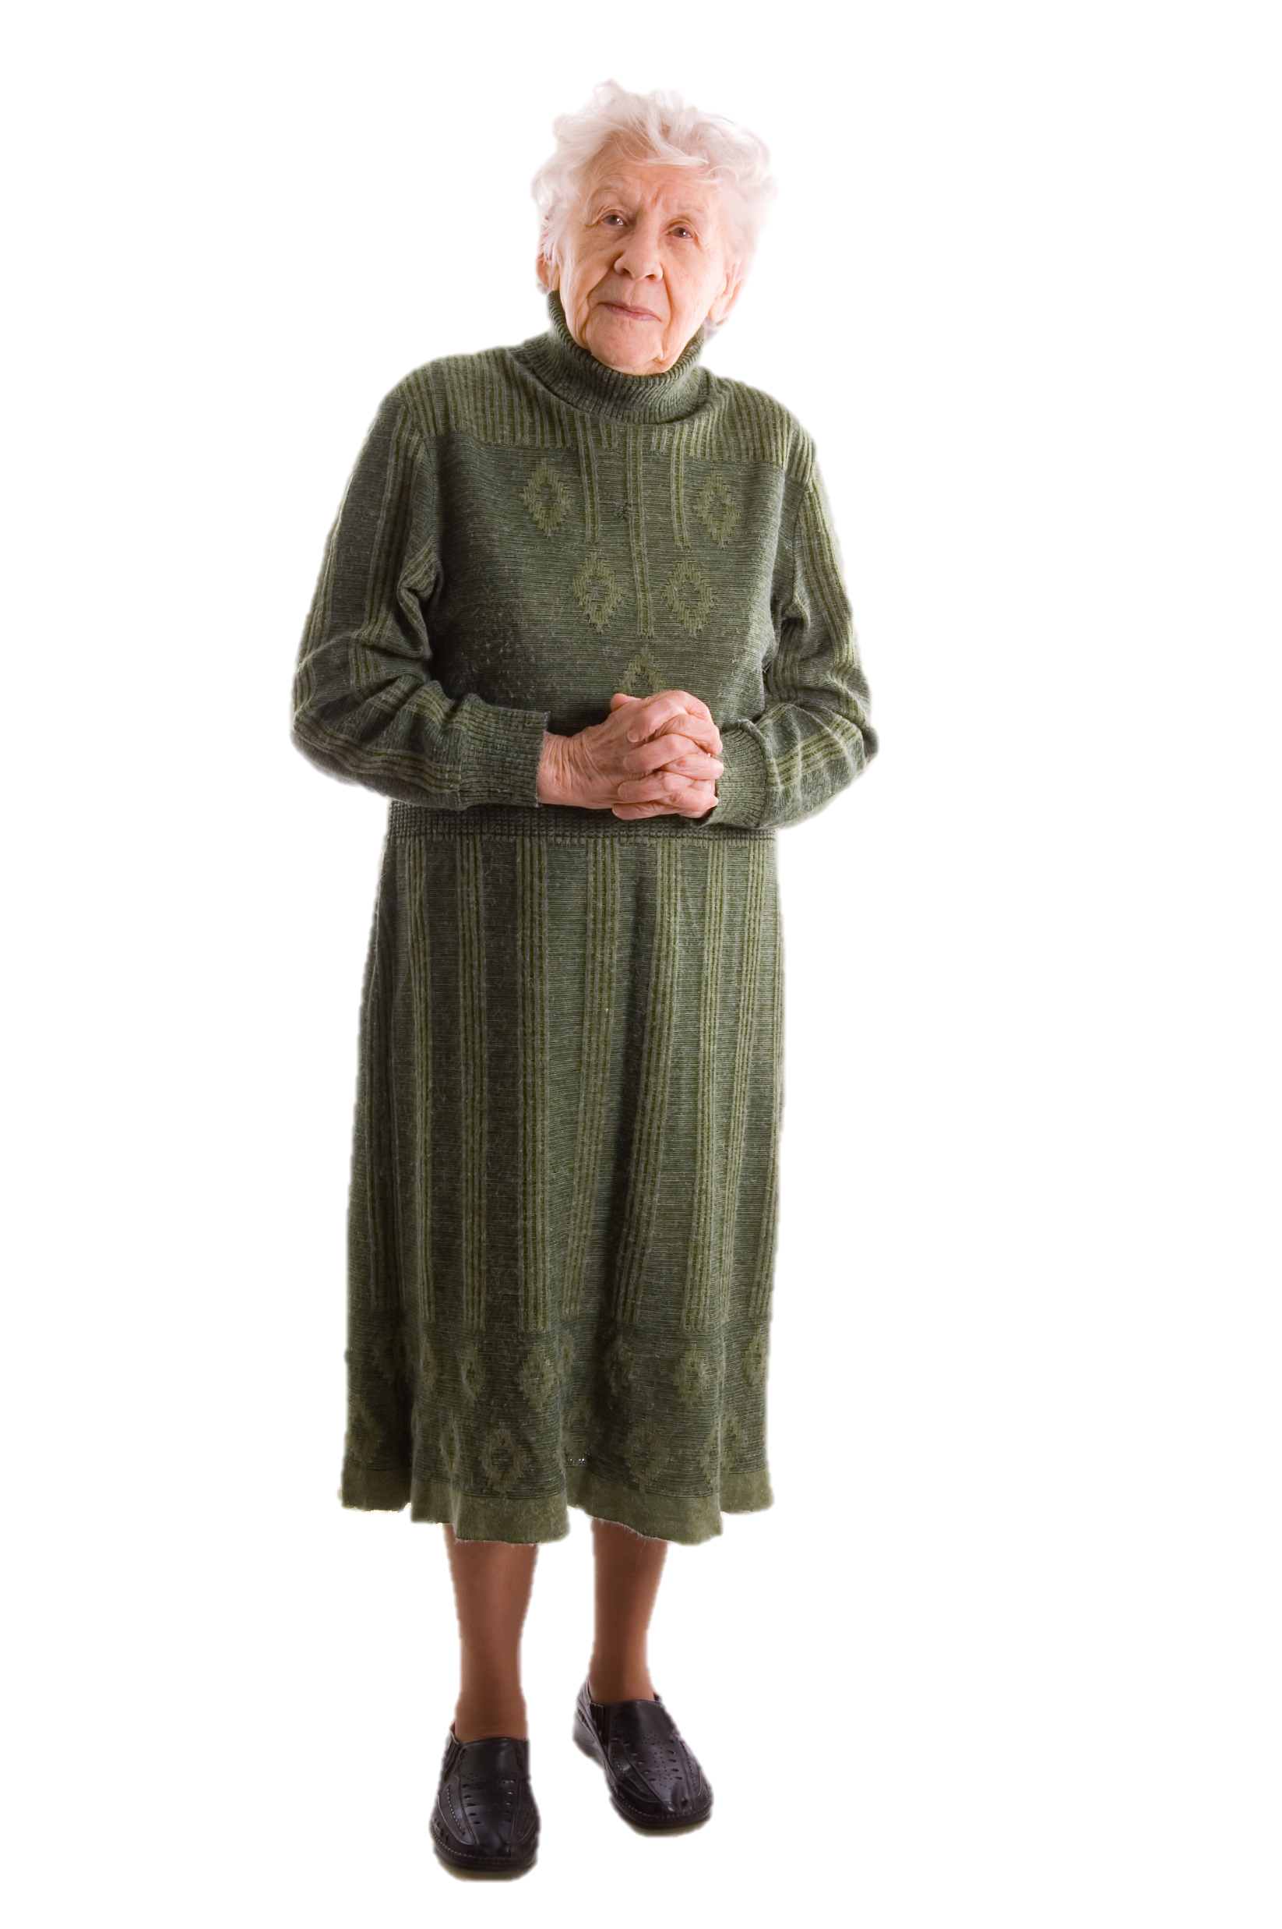

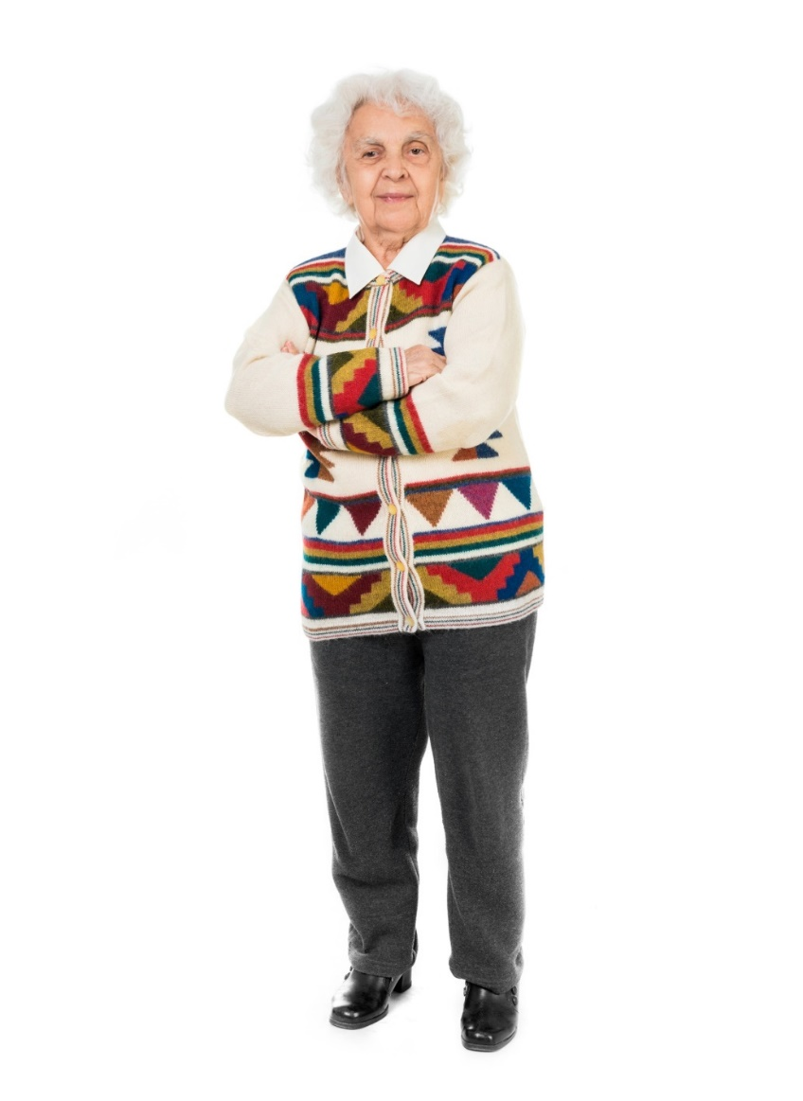

Case 9
CASE 5
Optimizing The Use and Dosing of DOACs in Patients with AF

Slide 2

Learning Objectives
Upon completion of this activity, participants should be able to:
I
Effectively manage the use and dosing of OAC therapy in patients with AF according to Canadian guideline recommendations
II
Summarize the randomized clinical trial evidence for stroke prevention benefits and bleeding risks of DOACs compared with Vitamin K OAC therapy
III
Discuss real-world treatment patterns, including appropriate dosing, with OAC therapy

Slide 3
Jean Bella
84 years old
Jean Bella comes in for a routine visit.
She feels generally well but complains of an occasional “skipped heartbeat”.
BP 135/75, Pulse 75 bpm - irregularly irregular.
Notes:
Speaker Notes:

Slide 4
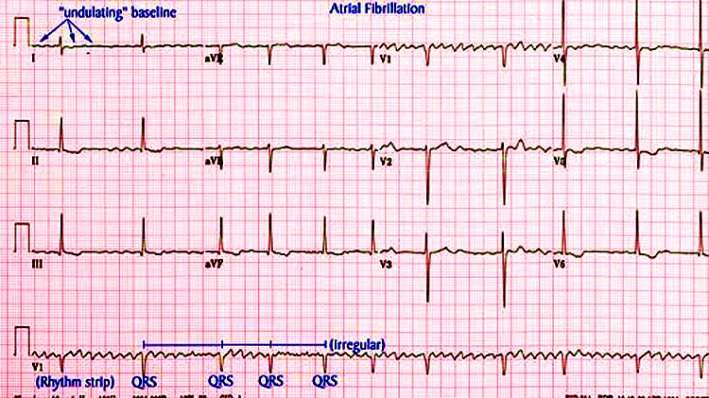
Jean Bella
84 years old
Jean Bella’s ECG
Notes:
Speaker Notes:
The ventricular response rate to this atrial fibrillation is auto-controlled. In the absence of therapy to accomplish this goal the finding of auto-controlled atrial fibrillation implies AV conduction system disease
(usually AV nodal) and predicts the ultimate requirement for a pacemaker.

Slide 5
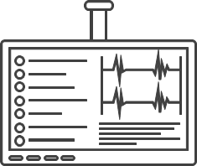
An Approach to the Patient with Newly Diagnosed Atrial Fibrillation
01
Assess urgency (symptomatic state, vitals, examination)
02
Must assess / control the ventricular response rate
03
Ask why and why now?
(electrolytes / creatinine / TSH, echocardiogram)
04
May consider establishing / maintaining sinus rhythm
05
Must consider stroke risk and stroke prevention
Notes:
Speaker Notes:

Slide 6
Jean Bella
84 years old
Relevant Case Findings:
Jean Bella had a myocardial infarction in 2010 and a stroke in 2015 (Rx: ASA 81 mg OD)
Weight: 58 kg
Serum Creatinine 102 µmol/L
eGFR 44 ml/min/1.73 m²
Notes:
Speaker Notes:

Slide 7
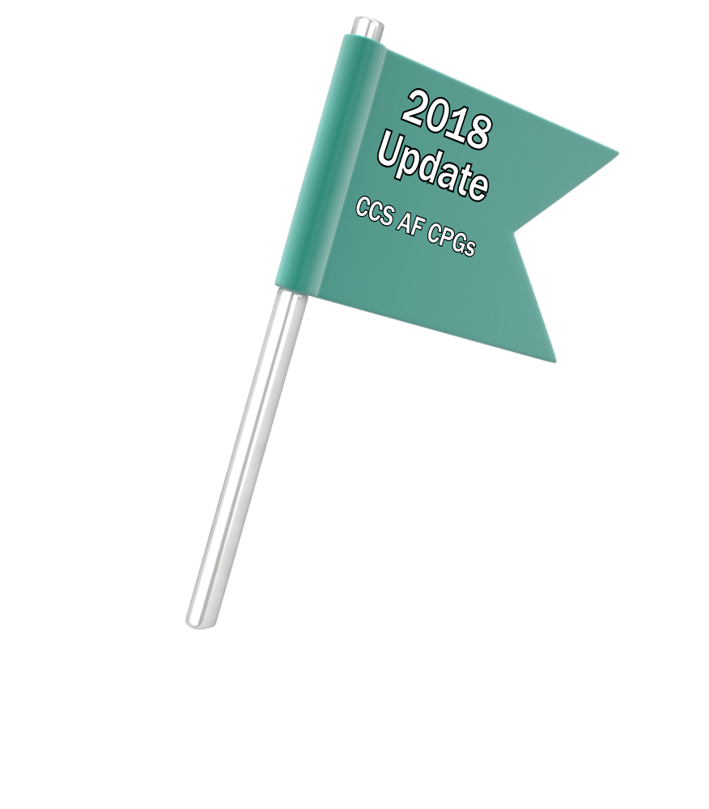
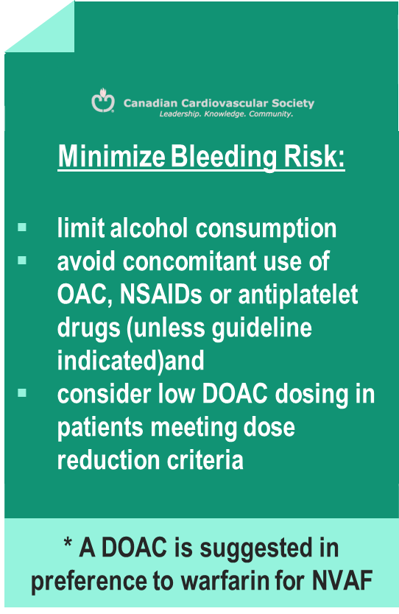
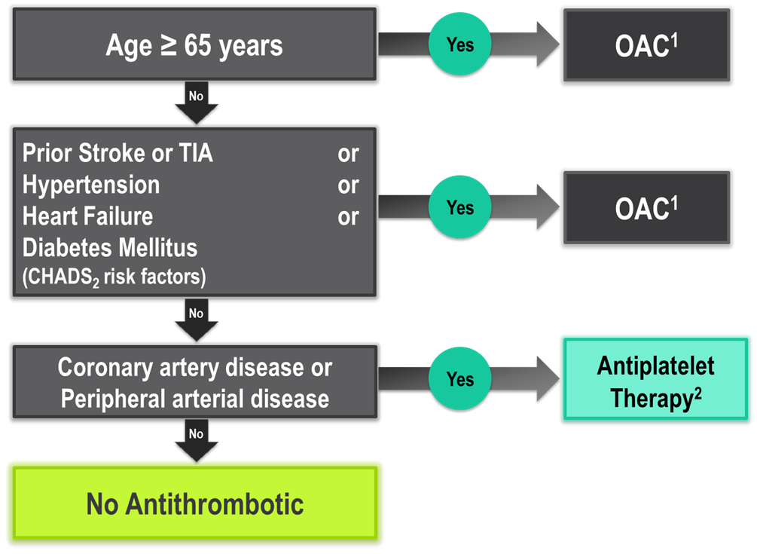
The “CCS Algorithm” (CHADS-65)
for OAC Therapy in AF
Andrade JG et al. Can J Cardiol 2018;34:1371-1392
CCS AF Guidelines. Can J Cardiol. 2016; 32: 1170-1185
¹ A DOAC is preferred over warfarin in non-valvular AF
² Therapeutic options include single antiplatelet therapy (ASA 81-100 mg daily) alone; or in combination with either a second antiplatelet agent (e.g. clopidogrel 75 mg daily or ticagrelor 60 mg BID), or an antithrombotic agent (rivaroxaban 2.5 mg BID)
Notes:
Speaker Notes:
This is the new and important slide from the 2018 (box to the right is from the 2016 update) Canadian AF guidelines update.
Two key points to emphasize: the (*) indicates that a DOAC should be selected in preference to an AVK for anticoagulation. The shaded box to the right emphasizes that all efforts should be made to select the correct DOAC dosage based on age, size and renal function as well as to minimize the bleeding risk by addressing any modifiable bleeding risk factors present.
There is no longer any need to calculate a patient’s HASBLED score as this does not influence management (most patients are antioagulated even, if at higher bleeding risk..)
Canada has not adopted the CHADSVASC scoring system to determine eligibility for oral anticoagulation in AF. The annual embolic stroke risk threshold for anticoagulation is set at 1.5% and it is felt that a vascular diseased patient who is aged 64 or less and CHADS2 = 0 has an annual stroke risk of less than 1.5% based on the Canadian Guideline Committee’s interpretation of currently available large data sets.

Slide 8
DOACs as Compared to Warfarin Indirect Comparisons from the Clinical Trials
 | Apixaban¹ | Dabigatran 110² | Dabigatran 150² | EDOXABAN 60 | Rivaroxaban³
Stroke/SE
Major Bleed
Intracranial Bleed
GI Bleed
All Cause Death
To date there are no head-to-head trials between apixaban, dabigatran, edoxaban and rivaroxaban, therefore comparative efficacy and safety have not been established
Significant Increase
Significant Reduction
Non-Significant Difference
Granger et al., NEJM 2011; 365: 981-992
Connolly et al., NEJM 2009; 361: 1139-1151
Patel et al., NEJM 2011; 365: 883-891
Giuliano RP et al NEJM 2013; 369:2091
Notes:
Speaker Notes:
This slide shows some key efficacy and safety outcome data vs. warfarin from the four major DOAC trials: RE-LY, ROCKET, ARISTOTLE and ENGAGE
Apixaban and Dabigatran 150 mg were associated with significant reduction of stroke/SE vs. warfarin.
Apixaban, Dabigatran 110 mg and Edoxaban were associated with significant reduction of major bleeding vs. warfarin.
All DOACs were associated with a significant reduction of intracranial bleeding (ICH) compared to warfarin.
Dabigatran 150 mg, Edoxaban and Rivaroxaban were associated with an increase in GI bleeding vs. warfarin.
Apixaban is associated with a significant reduction in mortality compared to warfarin.
Definition of major bleeding:
RE-LY: a reduction in the hemoglobin level of at least 20 g per liter, transfusion of at least 2 units of blood, or symptomatic bleeding in a critical area or organ.
ROCKET: as clinically overt bleeding associated with any of the following: fatal outcome, involving a critical site (i.e., intracranial, intraspinal, intraocular, pericardial, intraarticular, intramuscular with compartment syndrome, or retroperitoneal), or clinically overt bleeding associated with a fall in hemoglobin concentration of ≥ 2 g/dL, or leading to transfusion of ≥ 2 units of packed red blood cells or whole blood.
ARISTOTLE: clinically overt bleeding accompanied by a decrease in the hemoglobin level of at least 2 g per deciliter or transfusion of at least 2 units of packed red cells, occurring at a critical site, or resulting in death.
ENGAGE: International Society of Thrombosis and Hemostasis definition : clinically overt bleeding accompanied by a decrease in the hemoglobin level of at least 2 g per deciliter or transfusion of at least 2 units of packed red cells, occurring at a critical site, or resulting in death.
References:
﻿Connolly SJ, et al; for the RE-LY Steering Committee and Investigators. Dabigatran versus warfarin in patients with atrial fibrillation. N Engl J Med 2009; 361:1139-1151.
Connolly SJ, et al; for the RE-LY Investigators. Newly identified events in the RE-LY trial. N Engl J Med 2010; 363(19):1875-1876.
Patel MR, et al; and the ROCKET AF Steering Committee for the ROCKET AF Investigators. Rivaroxaban versus warfarin in nonvalvular atrial fibrillation. N Engl J Med 2011; 365:884-891.
Granger CB, et al; for the ARISTOTLE Committees and Investigators. Apixaban versus warfarin in patients with atrial fibrillation. N Engl J Med 2011; 365:981-992.

Slide 9
Case 9
You decide to prescribe a DOAC to
Jean Bella

Slide 10
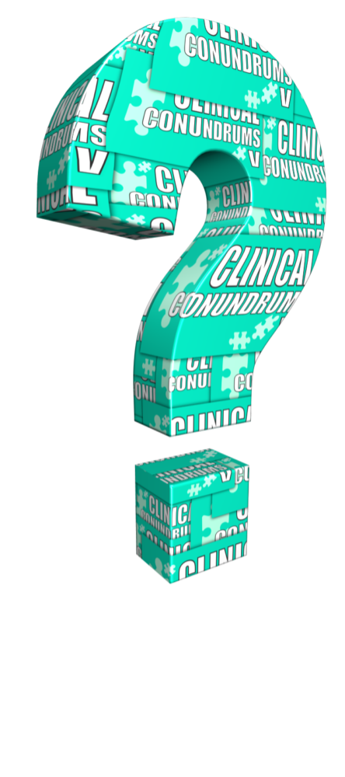
Is a DOAC dose adjustment required for Jean-Bella?
Choose one of the following options
Yes
No
Depends on the DOAC prescribed
Notes:
Speaker Notes:

Slide 11
Which DOAC would you prescribe to
Jean-Bella?
Select from one or more of the available options
Apixaban 5 mg BID
Apixaban 2.5 mg BID
Dabigatran 150 mg BID
Dabigatran 110 mg BID
Edoxaban 60 mg OD
Edoxaban 30 mg OD
Rivaroxaban 20 mg OD
Rivaroxaban 15 mg OD
Notes:
Speaker Notes:

Slide 12

Let’s Calculate Jean-Bella’s CrCl
Calculated Creatinine Clearance
(Cockcroft and Gault Formula)
Serum creatinine (µmol/l) | 102
Age (years) | 84
Weight (kg) | 58
Sex (m or f) | F
Creatinine clearance (mL/min) 33
Formula:
{(140 - Age) x wt (kg) x F} / (Plasma Creatinine * 0.8136) http://www.sydpath.stvincents.com.au/other/CalcsCrClCGumol.htm
Where F = 1 if male, and 0.85 if female
Notes:
Speaker Notes:

Slide 13
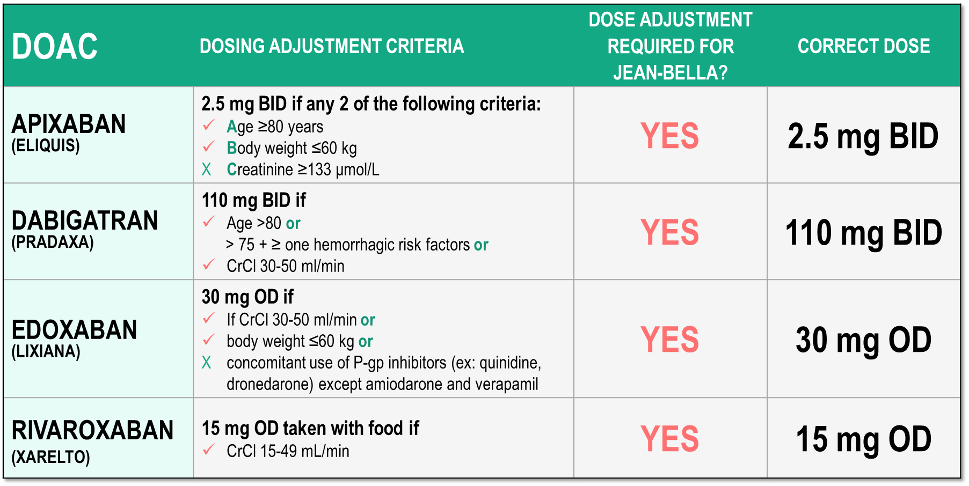
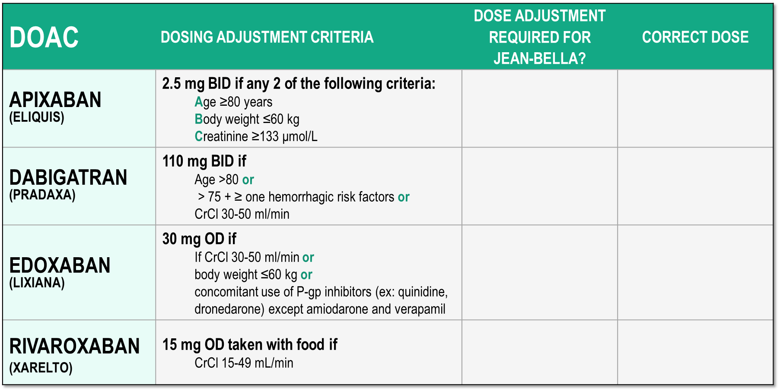
Considerations for Dosing of DOACs
Pfizer Canada Inc./BMS Canada. Eliquis (apixaban) Product Monograph, 2018.
Boehringer Ingelheim Canada Ltd. Pradaxa (dagbatran) Product Monograph. August 11, 2016.
Bayer Inc. Xarelto (rivaroxaban) Product Monograph. 2018.
Daiichi Sankyp Inc. Lixiana (edoxaban) Product Monograph. 2017.
Notes:
Speaker Notes:
Animated slide

Slide 14
Would you keep Jean-Bella on the ASA?
Choose one of the following options
Yes
No
Notes:
Speaker Notes:

Slide 15

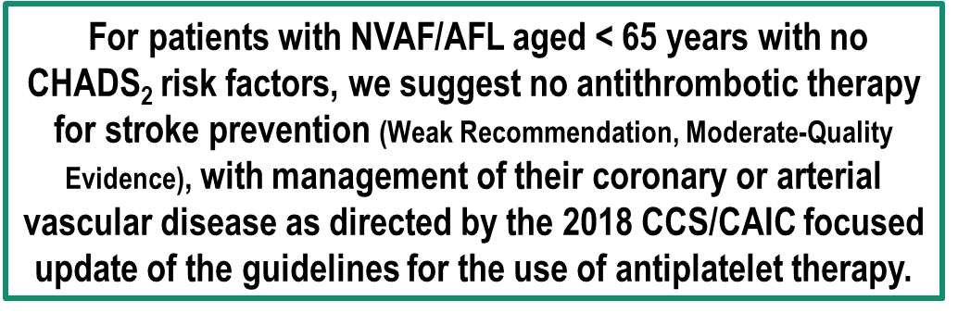
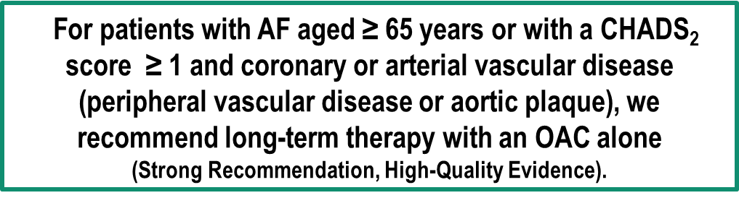
2018 Focused Update of the
CCS AF Guidelines
RECOMMENDATIONS
ASA alone is appropriate in AF patients at low risk of embolic stroke (< 1.5%/yr)
DOAC alone is appropriate in AF patients with stable CAD when anticoagulation is indicated (risk of embolic stroke ≥ 1.5 %/yr)
Andrade JG et al. Can J Cardiol 2018;34:1371-1392
Notes:
Speaker Notes:
Values and Preferences:
For patients with AF and stable coronary or arterial vascular disease, the CCS AF Guidelines Committee believed that routine use of combination therapy (an OAC with a single antiplatelet agent) was not justified because of the increased risk of bleeding without a significant reduction in ischemic coronary and cerebrovascular thrombotic events.

Slide 16

Ruth
78 years old
Ruth was recently diagnosed with Atrial Fibrillation
She feels generally well but complains of an occasional “skipped heartbeat” a few times a month.
BP 128/70, Pulse 78 bpm - irregularly irregular.
Notes:
Speaker Notes:

Slide 17
Ruth
78 years old
Relevant Case Findings:
Weight: 61 kg
Serum Creatinine 133 µmol/L
eGFR 37 ml/min/1.73 m²
Notes:
Speaker Notes:

Slide 18

Case 9
You decide to prescribe a DOAC to
Ruth

Slide 19
Is a DOAC dose adjustment required for Ruth?
Choose one of the following options
Yes
No
Depends on the DOAC prescribed
Notes:
Speaker Notes:

Slide 20
Which DOAC would you prescribe to
Ruth?
Select from one or more of the available options
Apixaban 5 mg BID
Apixaban 2.5 mg BID
Dabigatran 150 mg BID
Dabigatran 110 mg BID
Edoxaban 60 mg OD
Edoxaban 30 mg OD
Rivaroxaban 20 mg OD
Rivaroxaban 15 mg OD
Notes:
Speaker Notes:

Slide 21
Let’s Calculate Ruth’s CrCl
Calculated Creatinine Clearance
(Cockcroft and Gault Formula)
Serum creatinine (µmol/l) | 133
Age (years) | 78
Weight (kg) | 61
Sex (m or f) | F
Creatinine clearance (mL/min) 30
Formula:
{(140 - Age) x wt (kg) x F} / (Plasma Creatinine * 0.8136) http://www.sydpath.stvincents.com.au/other/CalcsCrClCGumol.htm
Where F = 1 if male, and 0.85 if female
Notes:
Speaker Notes:

Slide 22
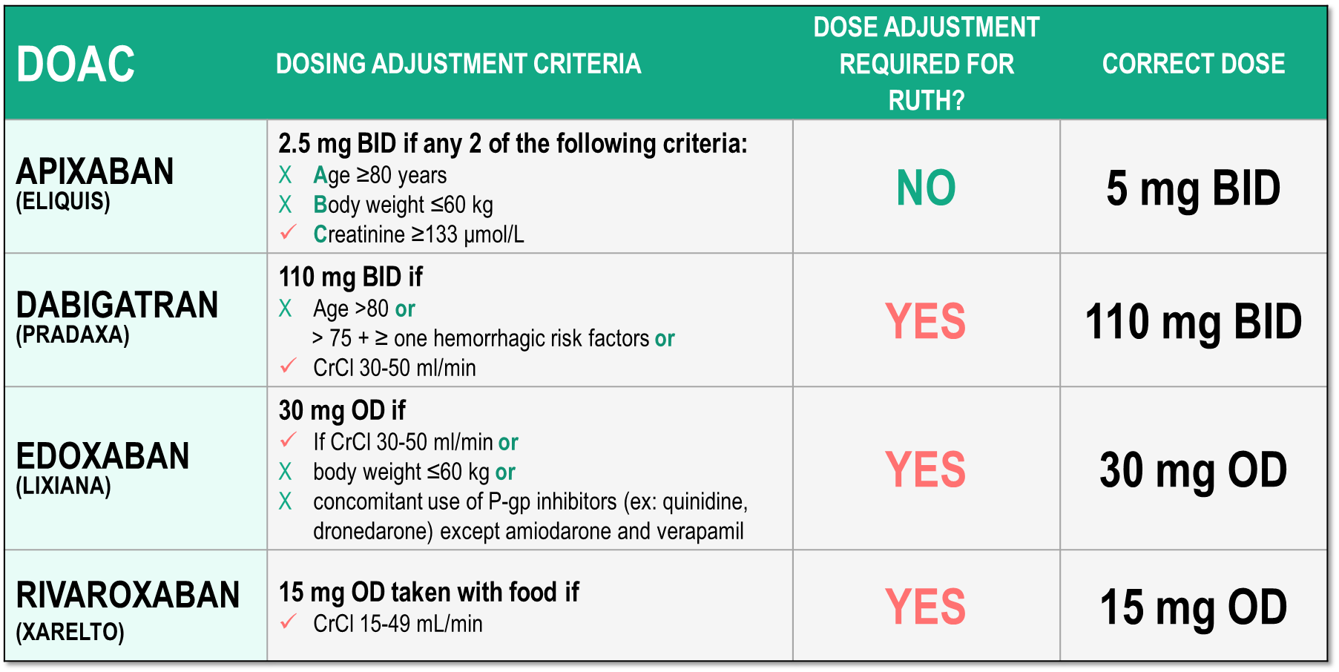

Considerations for Dosing of DOACs
Pfizer Canada Inc./BMS Canada. Eliquis (apixaban) Product Monograph, 2018.
Boehringer Ingelheim Canada Ltd. Pradaxa (dagbatran) Product Monograph. August 11, 2016.
Bayer Inc. Xarelto (rivaroxaban) Product Monograph. 2018.
Daiichi Sankyp Inc. Lixiana (edoxaban) Product Monograph. 2017.
Notes:
Speaker Notes:
Animated slide

Slide 23
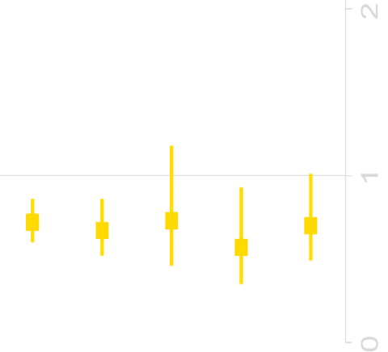
The Effect of Apixaban 5mg vs Warfarin is Maintained Regardless of Presence of Dose-reduction Criteria
Subgroup | Apixaban (%/year) | Warfarin (%/year) | HR (95% CI)
No DR criteria | 204 (1.8) | 279 (2.5) | 0.7 (0.6–0.9)
1 DR criterion | 102 (3.2) | 145 (4.8) | 0.7 (0.5–0.9)
Creatinine ≥1.5 mg/dL | 30 (4.2) | 40 (5.8) | 0.7 (0.5–1.2)
Weight ≤60 kg | 26 (2.3) | 44 (4.0) | 0.6 (0.4–0.9)
Age ≥80 years | 46 (3.5) | 61 (4.9) | 0.7 (0.5–1.1)
P_{interaction} = 0.71
0
1
2
Apixaban better
Warfarin better
*Primary outcome.
CI, confidence interval; DR, dose reduction; HR, hazard ratio; ISTH, International Society on Thrombosis and Haemostasis.
Alexander JH, et al, JAMA Cardiol 2016
Notes:
Speaker Notes:
This slide shows the rates of major bleeding by treatment and dose-reduction criteria.
Irrespective of the presence of 1 or no dose-reduction criteria, the treatment effect of apixaban 5 mg BID vs warfarin for the outcome of major bleeding was consistent with the overall results (P_{interaction} = 0.71).
The effect of apixaban 5 mg BID compared with warfarin on the risk of major bleeding was consistent across the range of age, weight, and creatinine clearance observed in the ARISTOTLE population.

Slide 24
Priya
67 years old
Atrial Fibrillation (less than a year)
Priya’s weight is 86 kg
Her serum creatinine is 72 µmol/l and her eGFR is 78 ml/min/1.73 m²
She is on edoxaban 30 mg once a day.
Notes:
Speaker Notes:

Slide 25
Is Edoxaban 30 mg OD the
correct dose for Priya?
Choose one of the following options
Yes
No
Notes:
Speaker Notes:

Slide 26
Let’s Calculate Priya’s CrCl
Calculated Creatinine Clearance
(Cockcroft and Gault Formula)
Serum creatinine (µmol/l) | 72
Age (years) | 67
Weight (kg) | 87
Sex (m or f) | F
Creatinine clearance (mL/min) 92
Formula:
{(140 - Age) x wt (kg) x F} / (Plasma Creatinine * 0.8136) http://www.sydpath.stvincents.com.au/other/CalcsCrClCGumol.htm
Where F = 1 if male, and 0.85 if female
Notes:
Speaker Notes:

Slide 27
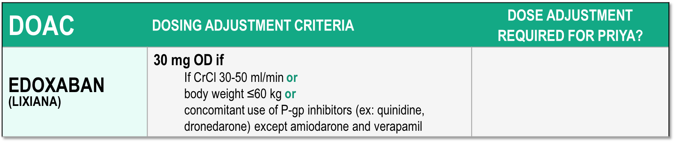

Considerations for Dosing of DOACs
NO
Correct Dose: 60 mg OD
Daiichi Sankyp Inc. Lixiana (edoxaban) Product Monograph. 2017.
Notes:
Speaker Notes:

Slide 28

Ethel
83 years old
Chronic atrial fibrillation for the past 5 years
Ethel’s weight is 51 kg
Her serum creatinine is 110 µmol/l and her eGFR is 44 ml/min/1.73 m²
She is on dabigatran 110 mg BID
Notes:
Speaker Notes:

Slide 29
What would you do with respect to Ethel’s OAC?
Select from one or more of the available options
No change – continue Dabigatran 110 mg BID
Switch to Dabigatran 150 mg BID
Switch to Apixaban 5 mg BID
Switch to Apixaban 2.5 mg BID
Switch to Edoxaban 60 mg OD
Switch to Edoxaban 30 mg OD
Switch to Rivaroxaban 20 mg OD
Switch to Rivaroxaban 15 mg OD
Switch her to Warfarin
Notes:
Speaker Notes:

Slide 30
Let’s Calculate Ethel’s CrCl
Calculated Creatinine Clearance
(Cockcroft and Gault Formula)
Serum creatinine (umol/l) | 110
Age (years) | 83
Weight (kg) | 51
Sex (m or f) | F
Creatinine clearance (mL/min) 28
Formula:
{(140 - Age) x wt (kg) x F} / (Plasma Creatinine * 0.8136) http://www.sydpath.stvincents.com.au/other/CalcsCrClCGumol.htm
Where F = 1 if male, and 0.85 if female
Notes:
Speaker Notes:

Slide 31
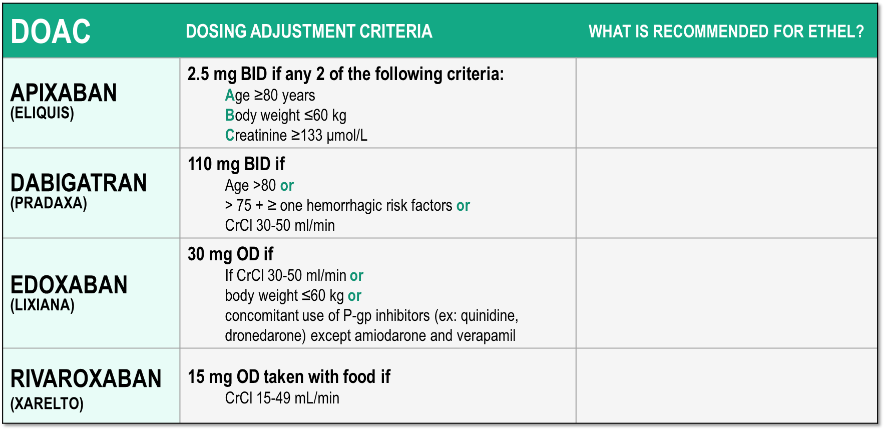

Considerations for Dosing of DOACs
2.5 mg BID
Contraindicated
Not Recommended
15 mg OD
Daiichi Sankyp Inc. Lixiana (edoxaban) Product Monograph. 2017.
Notes:
Speaker Notes:

Slide 32
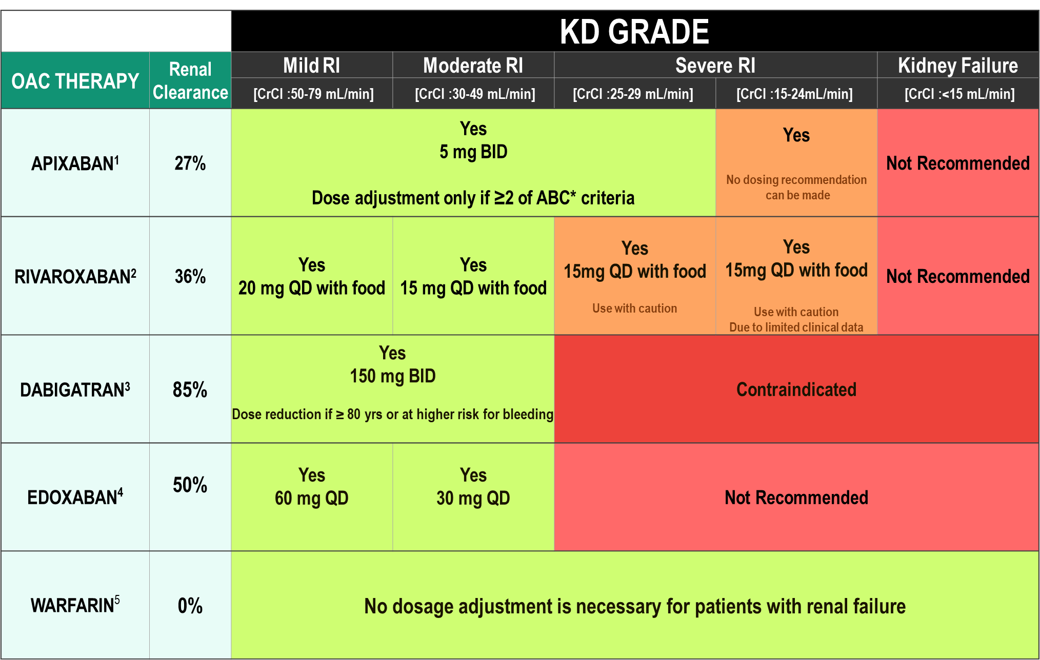
DOAC Dosing Recommendations for Stroke Prevention in AF in Patients with Renal Impairment According to the Canadian Product Monographs
Pfizer Canada Inc./BMS Canada. Eliquis (apixaban) Product Monograph, 2018.
Boehringer Ingelheim Canada Ltd. Pradaxa (dagbatran) Product Monograph. August 11, 2016.
Bayer Inc. Xarelto (rivaroxaban) Product Monograph. 2018.
Daiichi Sankyp Inc. Lixiana (edoxaban) Product Monograph. 2017.

Slide 33

Case 9
What are some of reasons why physicians prescribe lower than recommended doses of DOACs?
Notes:
Speaker Notes:

Slide 34
Misconceptions About DOAC Under and Over Dosing
Physicians choosing a lower dose of a DOAC are often driven by fear of causing a bleed
Nonetheless, by lowering the dose of a DOAC (or not anticoagulating at all), patients are at increased risk for stroke because of inadequate treatment
Physicians perceive older patients with AF having a stroke as the “natural course” of the disease vs. causing a bleed as a result of their actions
Notes:
Speaker Notes:

Slide 35
Case 9
What are the patterns of DOAC dosing in American and Canadian practice?
Notes:
Speaker Notes:

Slide 36
Use of Oral Anticoagulation in Canadian Patients with NVAF
7,019 patients with NVAF from 735 primary care physician practices
Over 90% of patients with CHADS₂ >1 receiving oral anticoagulation
BUT ….
Over 50% of patients on OAC taking warfarin
30.9% of patients on warfarin TTR < 65%
Of the patients on DOACs, 11.7% were on the wrong dose
7.4% under-dosed
4.3% over-dosed
Additional 3.2% of patients on DOAC were contraindicated by renal function
NVAF: Non Valvular Atrial Fibrillation
Bell AD, et al. Am J Cardiol. 2016 Apr 1;117(7):1107-11

Slide 37
DOAC Under- and Over-Dosing and Associated Outcomes: ORBIT-AF II
Observational analysis of the Outcomes Registry for Better Informed Treatment of Atrial Fibrillation phase II (ORBIT-AF II) project suggested
DOAC under- (~9%) or over-dosing (~3%) in patients according to U.S. labeling
Overdosing associated with increased all-cause mortality
Underdosing associated with increased risk for cardiovascular hospitalization
Steinberg BA, et al. J Am Heart Assoc. 2018 Feb 16;7(4)
Notes:
Speaker Notes:
Abstract
BACKGROUND:
Non-vitamin K antagonist oral anticoagulants (NOACs) are indicated for stroke prevention in atrial fibrillation (AF) but require lower doses in certain patients. We sought to describe the frequency, appropriateness (according to Food and Drug Administration labeling), and outcomes of patients prescribed reduced doses of NOACs in community practice.
METHODS AND RESULTS:
We analyzed data from the ORBIT-AF II (The Outcomes Registry for Better Informed Treatment of Atrial Fibrillation II) registry, a prospective, national, observational registry of AF patients. Among 7925 AF patients receiving NOACs, we assessed patterns of use of reduced NOAC doses and associated cardiovascular and bleeding outcomes at median follow-up of 1 year. Overall, 6636 patients (84%) received a NOAC at standard dose, which was consistent with US Food and Drug Administration labeling in 6376 (96%). Reduced NOAC dose was prescribed to 1289 (16% overall), which was consistent with Food and Drug Administration labeling in only 555 patients (43%). Compared with those whose NOAC dose was appropriately reduced, patients receiving inappropriate dose reductions were younger (median age 79 versus 84, P<0.0001) and had lower ORBIT bleeding risk scores (26% ≥4 versus 45%, P<0.0001). Compared with those appropriately receiving standard dosing, patients receiving inappropriately reduced-dose NOACs had higher unadjusted rates of thromboembolic events (2.11 versus 1.35 events per 100 patient years, hazard ratio 1.56, 95% confidence interval 0.92-2.67) and death (6.77 versus 2.60, hazard ratio 2.61, 95% confidence interval 1.86-3.67). After adjustment, outcomes were not significantly different but tended to favor patients dosed appropriately.
CONCLUSIONS:
The majority of dose reductions of NOACs in AF are inconsistent with US Food and Drug Administration recommendations. There appear to be opportunities to improve current NOAC dosing in community practice.

Slide 38
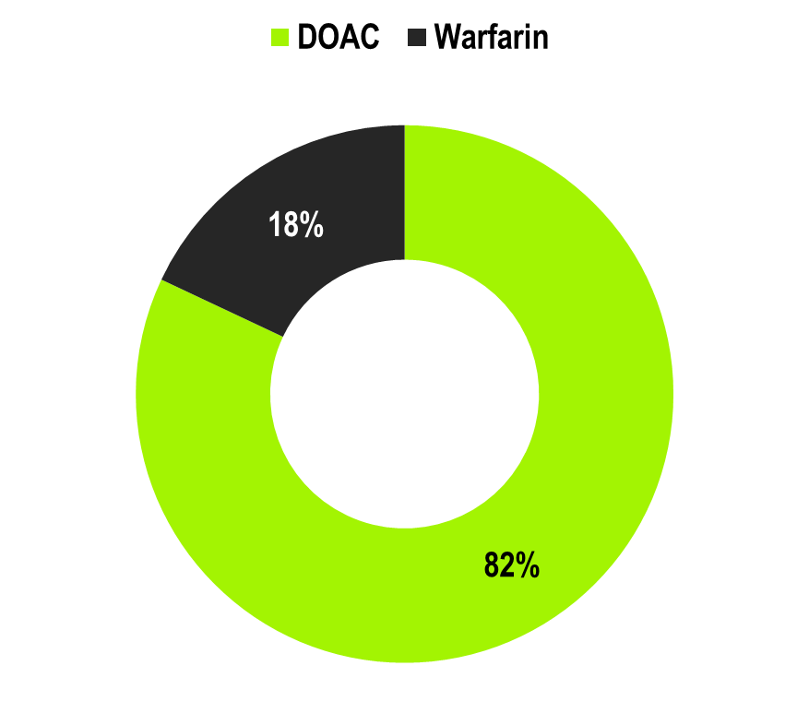
OPTIMAL AF: Oral Anticoagulant Used in Canada in 2018
1641 Canadian NVAF patients enrolled by 102 physicians (8 provinces):
More than 8 in 10 patients were receiving a DOAC for stroke prevention as per CCS AF Guideline recommendations
n=1,681
Non-vitamin K antagonist Oral Anticoagulant (NOAC) Use and Dosing in Canadian Practice: Insights from the Optimizing PharmacoTherapy in the Management Approach to Lowering risk in Atrial Fibrillation (OPTIMAL-AF) Program - CCS 2018 Poster Presentation
Notes:
Speaker Notes:
1641 Canadian NVAF patients enrolled by 102 physicians (91 Primary Care Physicians, 11 Cardiologists/Internists in 8 provinces):
More than 8 in 10 patients were receiving a DOAC for stroke prevention as per CCS AF Guideline recommendations
Reduced dosing of DOAC was frequently not concordant with Health Canada product monograph-recommended criteria
Lower-than-recommended NOAC dosing by Canadian physicians appears to occur be associated with concerns regarding advanced age, renal dysfunction, and perceived high bleeding risk
Despite relatively infrequent apparent lower-than-recommended dosing (~1 in 13 patients) and higher-than-recommended dosing (~1 in 33 patients) of NOAC, opportunities remain to further minimize the discordance between product monograph-based prescribing recommendations and DOAC dosing used in routine clinical practice
Methods
The OPTIMAL-AF program was a knowledge translation and quality improvement initiative. It was based on chart audit data collection and subsequent feedback to physicians regarding their stroke prevention management in an effort to support their choice (and dose) of therapies and thereby better achieve evidence-based, guideline-recommended antithrombotic treatment in NVAF patients. Canadian primary care physicians (PCPs) and specialists (Cardiology and Internal Medicine) were invited to participate and agreed to provide anonymized patient chart audit data through either an electronic medical record (EMR) system (TELUS Health® Platforms/Practice Solutions/Med Access, Montreal, Canada) or standardized, paper-based data collection forms. Central Research Ethics Board approval was obtained to allow for the waiver of individual patient informed consent and the publication of aggregate data.
A steering committee comprised of 3 cardiologists and 11 primary care physicians (PCPs) provided input on the program objectives, design, protocol, chart audit forms and feedback process. The Canadian Heart Research Centre (CHRC; Toronto, Canada), a not-for-profit academic research organization, was responsible for the coordination of the program, including statistical analysis. Support for the program was provided through an unrestricted grant from the Bristol Myers Squibb/Pfizer Canada alliance.
Participating physicians provided anonymized patient data either through: (1) a single page, paper-based data collection form (faxed or mailed, and then scanned into a database using TELEform [version 10.0; Cardiff Software Inc., San Diego, California]); or, (2) via automatic abstraction from the electronic medical record The physicians then validated that the identified patients indeed had NVAF and were currently receiving OAC. Physicians participating in the paper-based chart audits were recruited to participate by email and identified through continuing medical education events, participation in previous or ongoing clinical trials, observational studies, or knowledge translation programs with the coordinating centre. Physicians providing paper- based data collection forms submitted data for 10 patients with NVAF from their practice. While physicians were encouraged to include consecutive patients, patients receiving warfarin could not comprise more than 20% of the sample. For the data obtained through the EMR process, all patients in the physician’s practice meeting the eligibility criteria were included.
Patients were eligible for inclusion if they were 18 years of age or older; had permanent, paroxysmal or persistent non-valvular AF (or atrial flutter) identified on a 12-lead electrocardiogram (ECG), rhythm strip, pacemaker/ implantable cardioverter-defibrillator, or continuous ECG recording with >30 seconds of continuous AF and were currently receiving OAC. Patients were excluded if they had any of: mechanical heart valve, rheumatic mitral stenosis, or moderate or severe non-rheumatic mitral stenosis; severe renal dysfunction (creatinine clearance <20 ml/min/m2) or an apparent reversible cause of AF.
Patient data collected included demographics, medical history, current medications and treatments; and dose of NOAC. For patients receiving warfarin, the most recent INR value was recorded, and time-in-therapeutic-range (TTR) was calculated for the paper-based chart audit patients based upon the last 6 INR values obtained. For patients receiving a reduced dose of a NOAC, concordance with the recommended dose per the Health Canada product monograph (Supplementary Appendix D) was determined. In the case of the reduced dose being discordant, the reason for the reduced dose was recorded. For the paper-based patients, data was also available regarding AF history, concurrent specialists or services co-managing the patient’s stroke prevention therapy (such as anticoagulation clinic) and antithrombotic drug coverage (i.e., provincial/national formulary, private insurance, both, or neither).
Descriptive analysis of demographic variables, regional distribution of patients and physicians, data related to medical history, OAC therapies, doses and reasons for discordant doses were performed using SAS software v. 9.4 (SAS Institute, Cary, North Carolina, United States).
Results
The total number of patients receiving OAC was 1681. Detailed demographic data was provided for 1641 patients by 102 physicians from 8 provinces; 1087 patients (66%) were included via the EMR process and 554 (34%) via the paper-based method.There were 635 (39%) women and 90% (1477) of the patients were 65 years of age or older.
In the paper-based chart audit patients, the median (25th, 75th percentiles) CHADS₂, CHA₂DS₂VaSC, and HASBLED scores were 2 (1, 3), 4 (3, 5) and 2 (1, 2), respectively. In the EMR patients with known CHADS-65 status, 96% met the threshold for initiation of OAC for stroke prevention. All patients were receiving OAC: warfarin in 302 (18%) and NOAC in 1379 (82%). For patients receiving warfarin (n= 302), the most recent INR was available in 259 (86%) patients and was within the For patients receiving a NOAC (n=1379), more than 95% of patients met the CHADS-65 threshold for OAC. The distribution of NOAC agents was: 661 (48%) patients receiving apixaban, 243 (18%) dabigatran, 468 (34%) rivaroxaban, and 7 (<1%) edoxaban, respectively . The dose of NOAC was available in 1113 patients (81%): standard dose was prescribed in 849 (76%) and reduced dose in 264 (24%). Among those, the reduced dose was concordant with Health Canada prescribing information in 154 patients (58%). The standard dose was concordant in 805 (95%). Thus, 14% of patients on NOACs where the dose could be determined were receiving a dose discordant with prescribing recommendations; 10% were on a lower than recommended dose, and 4% were on a standard dose that should have been reduced. The top three reasons cited by the physicians providing paper-based data were age 80 years or more (58%), elevated creatinine (Creatinine 133 µmol/L or greater or eGFR less than 50 ml/min/1.73 m²) (35%), and prior bleeding or dose recommended by specialist (17% each). For the EMR-based patients, the top 3 reasons physicians provided for discordant reduced NOAC doses were elevated creatinine/low eGFR (36%), dose recommended by specialist (29%), and high bleeding risk (22%).

Slide 39
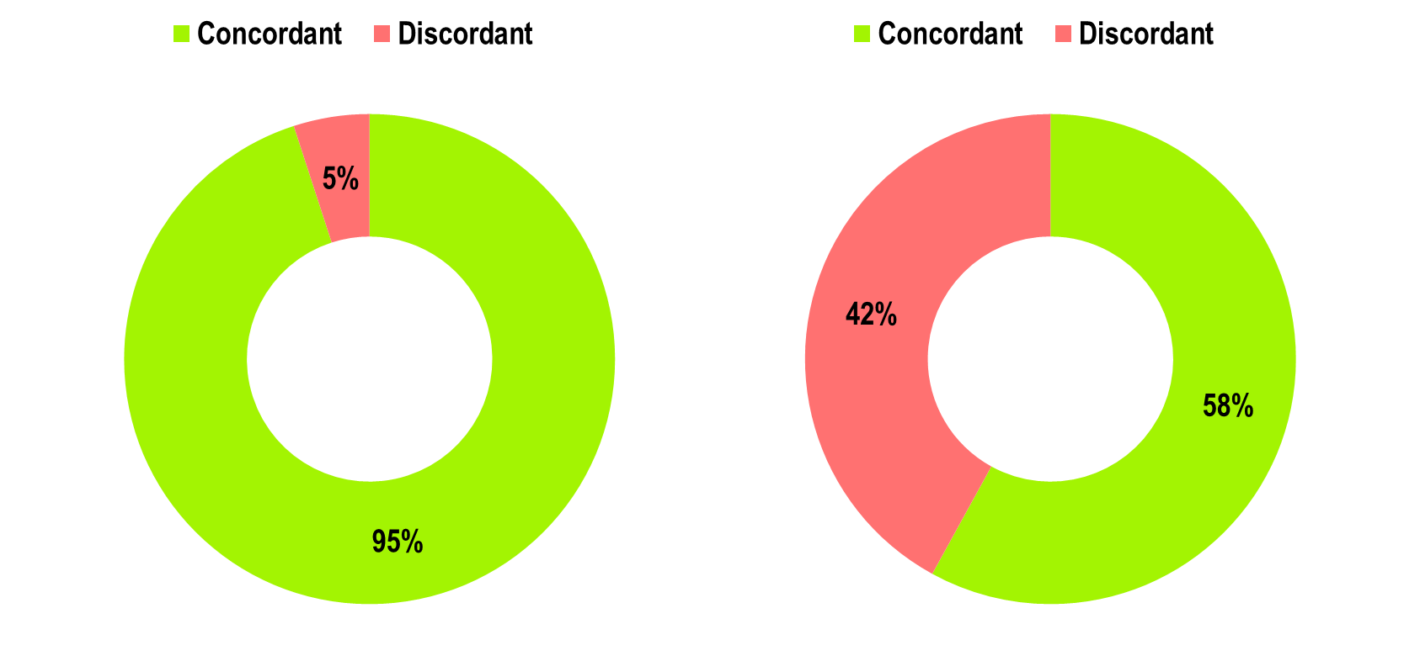
OPTIMAL AF:
DOAC Dose and Concordance*
Standard Dose (n=829)
Reduced Dose (n=264)
*Concordant with Health Canada Product Monograph prescribing recommendations
⁺Dosing information available
Non-vitamin K antagonist Oral Anticoagulant (NOAC) Use and Dosing in Canadian Practice: Insights from the Optimizing PharmacoTherapy in the Management Approach to Lowering risk in Atrial Fibrillation (OPTIMAL-AF) Program - CCS 2018 Poster Presentation
Notes:
Speaker Notes:
Reduced dosing of DOAC was frequently not concordant with Health Canada product monograph-recommended criteria

Slide 40
OPTIMAL-AF
DOAC Dose and Lower Dose Concordance*
Apixaban (n=556⁺)
Dabigatran (n=181⁺)
Rivaroxaban (n=369⁺)
*Concordant with Health Canada Product Monograph prescribing recommendations
⁺Dosing information available
Non-vitamin K antagonist Oral Anticoagulant (NOAC) Use and Dosing in Canadian Practice: Insights from the Optimizing PharmacoTherapy in the Management Approach to Lowering risk in Atrial Fibrillation (OPTIMAL-AF) Program - CCS 2018 Poster Presentation
Notes:
Speaker Notes:
Of the 556 AF patients on Apixaban, 23% were given the reduced dose of 2.5 mg bid of whom about half (13% of the total) did not have 2 of the 3 “ABC” criteria present (age ≥ 80, weight ≤ 60 kg, creatinine ≥ 133)
Of the 181 patients on Dabigatran, 38% were on the reduced dose of 110mg bid and only 4% were felt to be on a dosage that was discordant with current Canadian Guidelines
Of the 369 patients on Rivaroxaban, 18% were on a reduced dose and 8% were felt to have been reduced to 15 mg daily inappropriately.
Overall, the message is that there is some room for improvement through further knowledge dissemination

Slide 41
Case 9
What are the real-world outcomes in patents receiving reduced doses of DOACs?
Notes:
Speaker Notes:

Slide 42
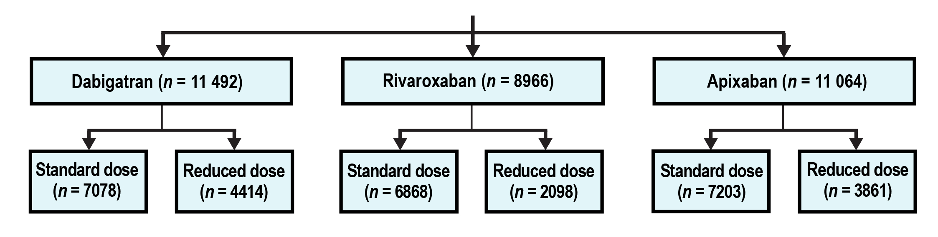
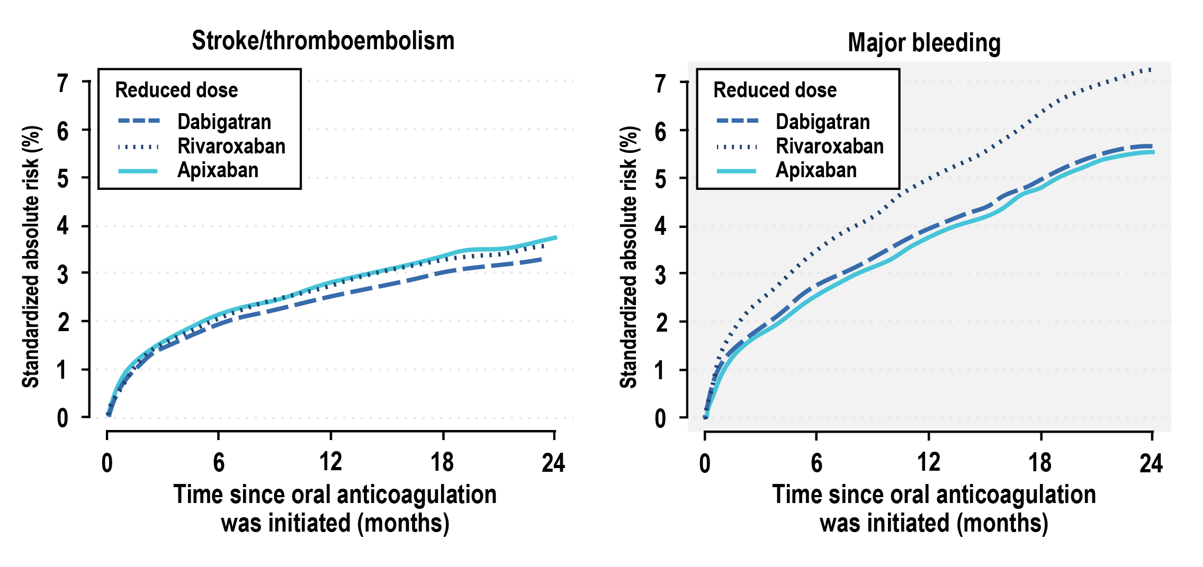
Standard and Reduced Doses of Dabigatran, Rivaroxaban and Apixaban for Stroke Prevention in AF: A National Cohort Study
*Head-to-head studies have not been conducted, therefore comparative safety and efficacy have not been established
Staerk et al. J Int Med, 2018 (283) 45-55
Notes:
Speaker Notes:
Background
Comparative data of non‐vitamin K antagonist oral anticoagulants (NOAC) are lacking in patients with atrial fibrillation (AF).
Objective
We compared effectiveness and safety of standard and reduced dose NOAC in AF patients.
Methods
Using Danish nationwide registries, we included all oral anticoagulant‐naïve AF patients who initiated NOAC treatment (2012–2016). Outcome‐specific and mortality‐specific multiple Cox regressions were combined to compute average treatment effects as 1‐year standardized differences in stroke and bleeding risks (g‐formula).
Results
Amongst 31 522 AF patients, the distribution of NOAC/dose was as follows: dabigatran standard dose (22.4%), dabigatran‐reduced dose (14.0%), rivaroxaban standard dose (21.8%), rivaroxaban reduced dose (6.7%), apixaban standard dose (22.9%), and apixaban reduced dose (12.2%). The 1‐year standardized absolute risks of stroke/thromboembolism were 1.73–1.98% and 2.51–2.78% with standard and reduced NOAC dose, respectively, without statistically significant differences between NOACs for given dose level. Comparing standard doses, the 1‐year standardized absolute risk (95% CI) for major bleeding was for rivaroxaban 2.78% (2.42–3.17%); corresponding absolute risk differences (95% CI) were for dabigatran −0.93% (−1.45% to −0.38%) and apixaban, −0.54% (−0.99% to −0.05%). The results for major bleeding were similar for reduced NOAC dose. The 1‐year standardized absolute risk (95% CI) for intracranial bleeding was for standard dose dabigatran 0.19% (0.22–0.50%); corresponding absolute risk differences (95% CI) were for rivaroxaban 0.23% (0.06–0.41%) and apixaban, 0.18% (0.01–0.34%).
Conclusions
Standard and reduced dose NOACs, respectively, showed no significant risk difference for associated stroke/thromboembolism. Rivaroxaban was associated with higher bleeding risk compared with dabigatran and apixaban and dabigatran was associated with lower intracranial bleeding risk compared with rivaroxaban and apixaban.

Slide 43
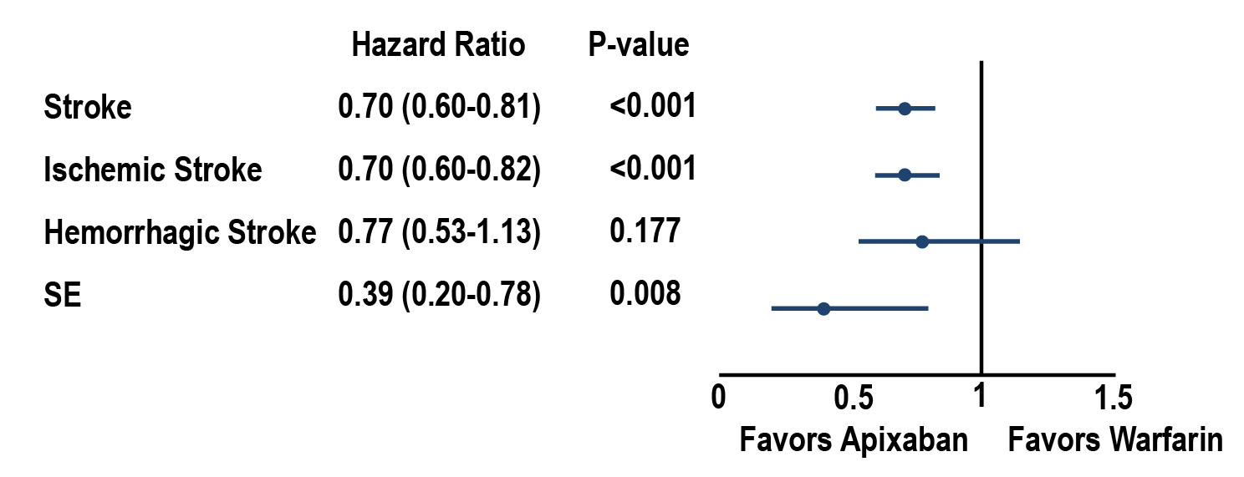
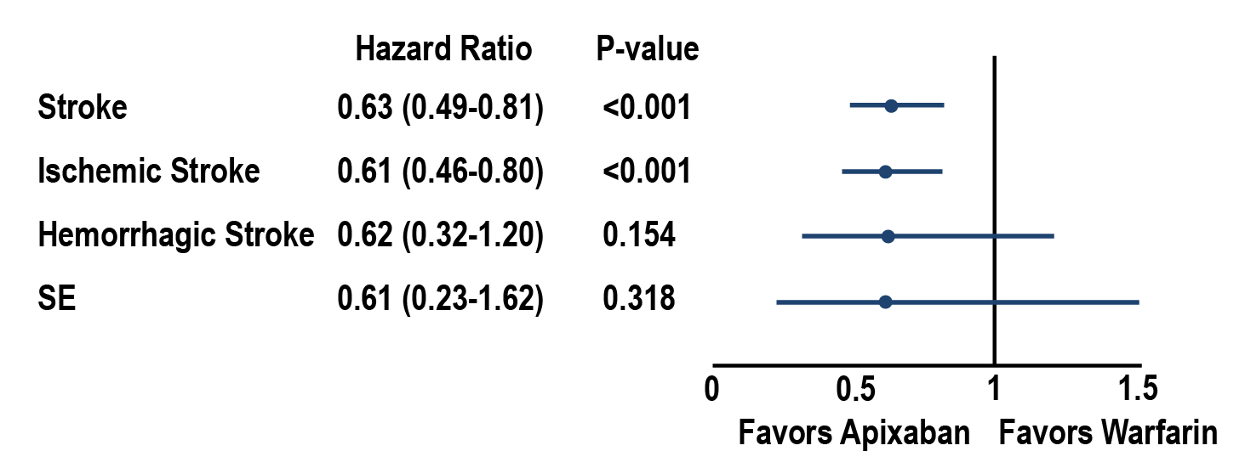
Standard and Reduced Doses of Dabigatran, Rivaroxaban and Apixaban for Stroke Prevention in AF: A National Cohort Study
5 mg BID dose, matched patients
(n=63,654)
Apixaban (n=31,827)
Warfarin (n=31,827)
2.5 mg BID dose, matched patients
(n=13,200)
Apixaban (n=6,600)
Warfarin (n=6,600)
Li, and al. Apixaban 5 and 2.5 mg twice-daily vs warfarin for stroke prevention in NVAF: Comparative effetiveness and Safety evaluated using propensity-score matched approach; Plos One, 2018
Notes:
Speaker Notes:
Cumulative incidence and hazard ratios of stroke/systemic embolism among 5 mg BID apixaban/warfarin patients. (A) Cumulative incidence of stroke/SE among propensity-score–matched 5 mg BID apixaban and warfarin patients. (B) Hazard ratios of stroke/SE for propensity-score–matched 5 mg BID apixaban and warfarin patients. BID, twice daily; stroke/SE, stroke/systemic embolism.
Cumulative incidence and hazard ratios of stroke/systemic embolism among 2.5 mg BID apixaban/warfarin patients. (A) Cumulative incidence of stroke/SE among propensity-score–matched 2.5 mg BID apixaban and warfarin patients. (B) Hazard ratios of stroke/SE for propensity-score–matched 2.5 mg BID apixaban and warfarin patients. Footnote: BID: twice daily; stroke/SE, stroke/systemic embolism.
Conclusion In this real-world study, 5 mg BID and 2.5 mg BID doses of apixaban were assessed for 2 patient groups that differed widely in age and clinical characteristics. Each apixaban dose was associated with a lower risk of stroke/SE and major bleeding compared with warfarin in the distinct population for which it is currently prescribed in US clinical practice. This study provides observational evidence to supplement the results of the ARISTOTLE trial, which found no significant interaction between dose and treatment effect regarding stroke/SE and major bleeding [5]. To confirm the findings of this observational study, additional research should be performed using different data sources (ideally data sources with comprehensive body weight and renal function laboratory values) and larger patient sample sizes

Slide 44

Key Messages
Stroke prevention with OAC, with a preference for a DOAC instead of a Vitamin K OAC, is a key step in the approach to the management of patients with NVAF
Individual patient characteristics (e.g., renal function, age, body weight) must be considered when choosing the appropriate dose of a DOAC
Concerns related to advanced age, renal dysfunction, and perceived high bleeding risk are associated with lower-than-recommended DOAC doses in Canadian NVAF patients
Opportunities remain to further minimize the discordance between Health Canada product monograph-based prescribing recommendations and DOAC dosing used in routine clinical practice
Notes:
Speaker Notes:

